Slide 1

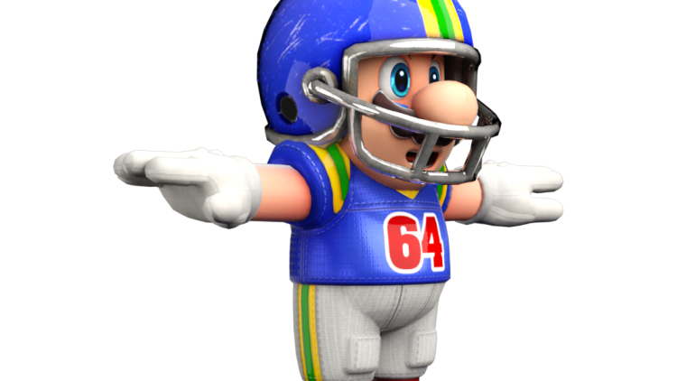

Football V
Produced by Dr. Mario | UNC STOR 390

Slide 2
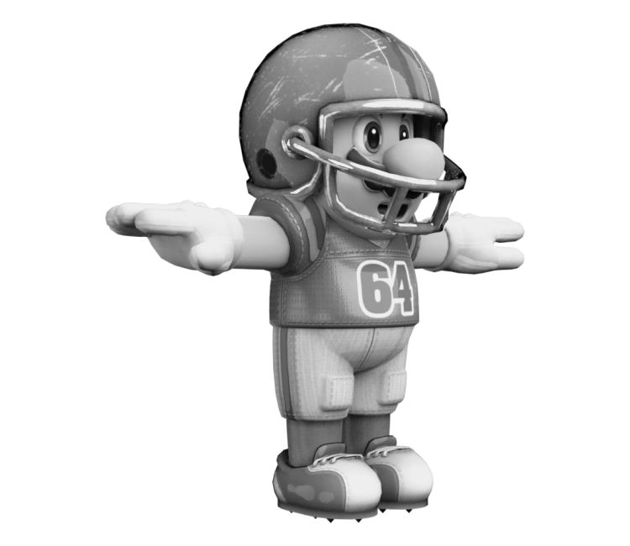
State and Value Analysis
Use Data Science to Appreciate the Sport
Case Study 2006 Super Bowl
Indianapolis Colts vs Chicago Bears
Tony Dungy vs Lovie Smith
Peyton Manning vs Rex Grossman
Final Score: 29 – 17
Peyton Manning’s Only Super Bowl
Book Uses State and Value Approach to Appreciate the Game

Slide 3
State and Value Analysis
Play-by-Play Logs for Each NFL Game
Down Before the Play
Yards to Go For a 1st Down Before the Play
Yard Line Before the Play
Was the Play a Run or Pass
The Ball Carrier on the Running Play
Where the Runner was Positioned
Quarterback and Intended Receiver
Classification of Pass Distance
Result of the Play Measured by Down, Distance to 1st Down, and Yard Line

Slide 4
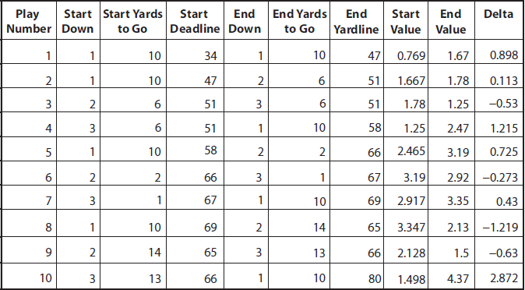
State and Value Analysis
Example of Data Used by Textbook

Slide 5
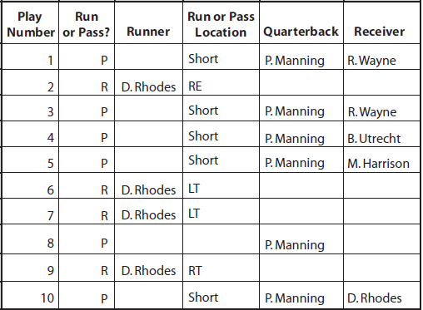
State and Value Analysis
Example of Data Used by Textbook

Slide 6
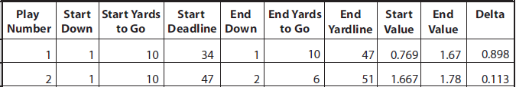
State and Value Analysis
Focus on Value Measures
Value of Starting State
Value of Ending State
How is This Useful?

Slide 7
State and Value Analysis
On First and 10, Is Running More Effective Than Passing?
Filter Data Based on 1st and 10 Situations
Split Data Into Running and Passing Plays
Colts Ran 222 Times and Averaged 0.119 Points Per Run
Colts Passed 204 Times and Averaged 0.451 Points Per Pass
Interesting: Colts Ran More than Passed But Won the Game
Shows the Importance of Looking at More Granular Data When
Making a Sports Argument
Are Runs More or Less Effective Than Passes?
Passing Plays Averaged 0.416 Points
Running Plays Averaged 0.102 Points
Clearly, They Should Pass Every Time. Any Problems Here?

Slide 8
State and Value Analysis
Which Runner Was More Effective?
Joseph Addai Averaged 0.134 Points Per Run
Dominique Rhode’s Averaged 0.041 Points Per Run
Which Receiver Was More Effective?
Passes to Reggie Wayne Averaged 0.67 Points (140 Passes)
Passes to Marvin Harrison Averaged 0.56 Points (152 Passes)
Where Could These Analyses Be Problematic?

Slide 9
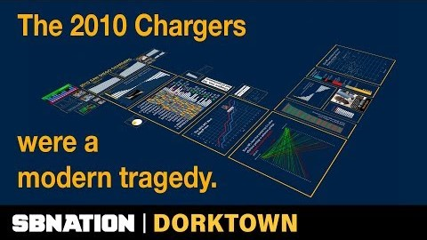
Football Decision Making
Now Check Out the 2010 San Diego Chargers

Slide 10
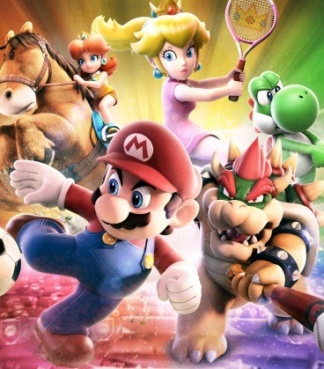
Final Inspiration
I want to be the greatest at mediocrity.
- Mahatma Mario

